Slide 1
Neural Network
Supervised by: Shivan Shkwr

Slide 2
Introduction
Inspired by the actual biological neural network, the biological brain, something called an artificial neural network can be built as a kind of computational system. So, what is the neuron in the code? How does it receive inputs? How does it generate outputs?
Our brain does this. It receives all these inputs from light in the room that travel through our retina and into the brain and the signals then produce outputs that allow us to catch something or read some words. How can that process be simulated in software? And what types of outcomes can we generate?

Slide 3
Introduction
So, we need to build and understand the perceptron and then we can start to connect the perceptrons together to create more sophisticated systems that can begin to generate outputs based on more complex inputs. This idea of having some data that we want to make sense of. That data is an input to a machine learning algorithm. That algorithm is going to generate an output. So maybe the data is an image that a machine learning algorithm is going to guess is a cat or a dog? Or to be something else according to the type of the problem.

Slide 4
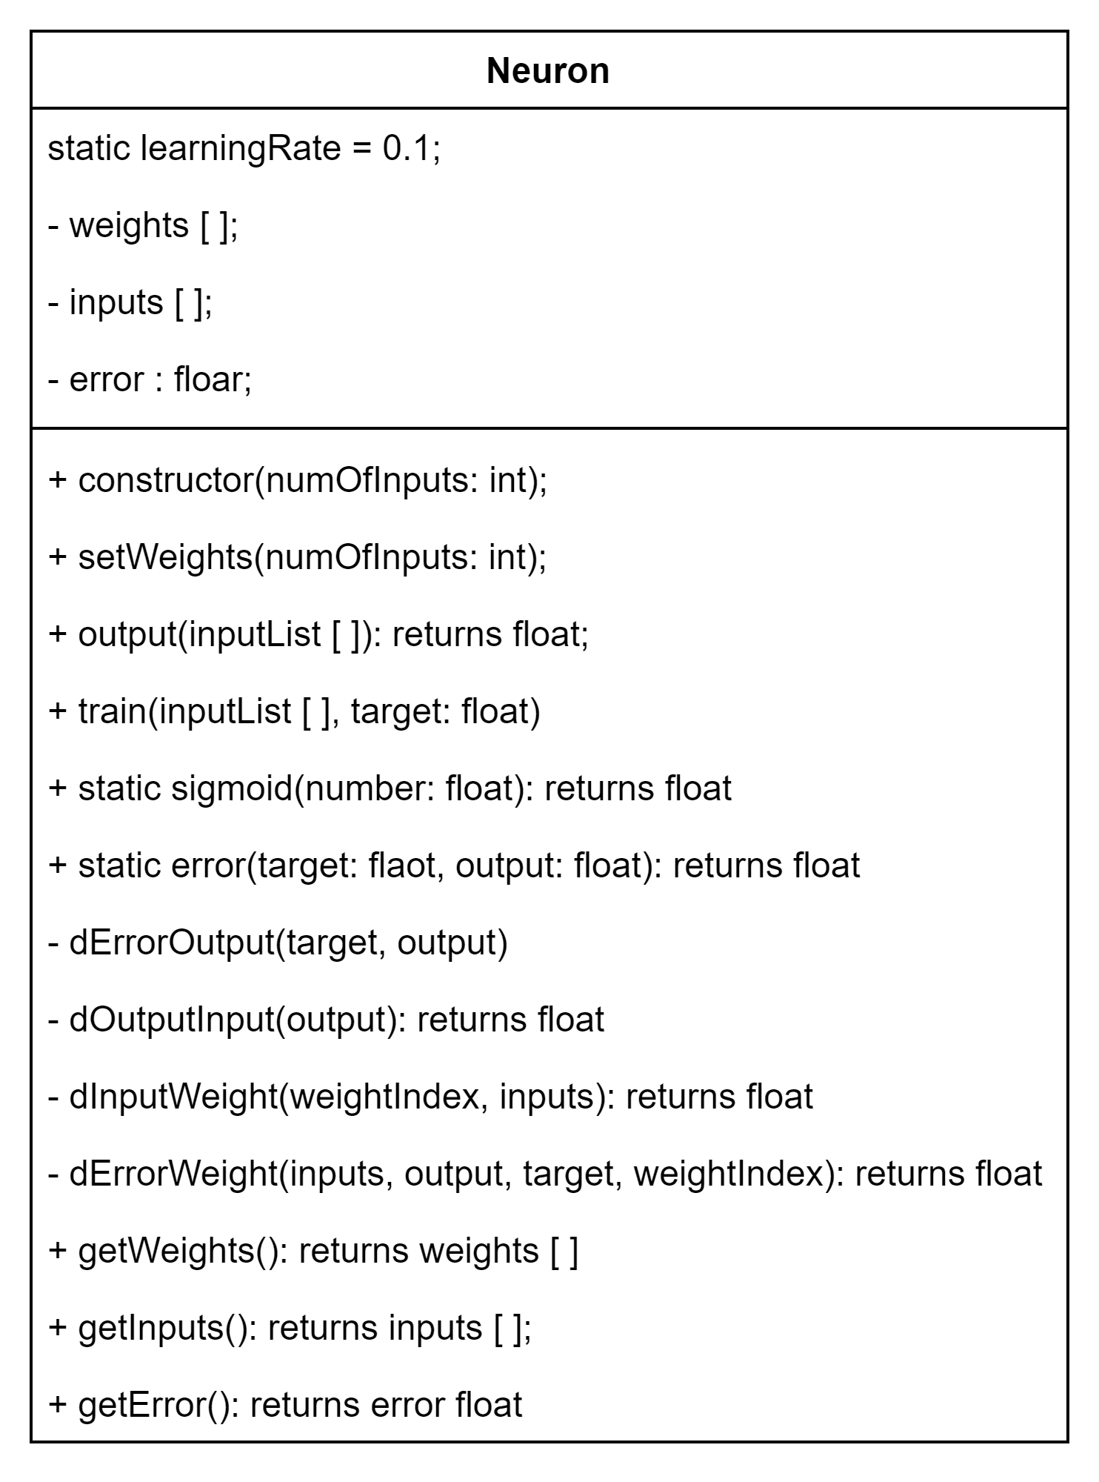
The Neuron
Simplest NN UML

Slide 5
Problem
The neural network that contains only one neuron is only useful for the linearly separable problems like (And - Or - XOR) gate. We need the multilayer neural network to be able to solve complex problems. So, we need to create the neural network class that will be using the neuron class inside its layers.

Slide 6
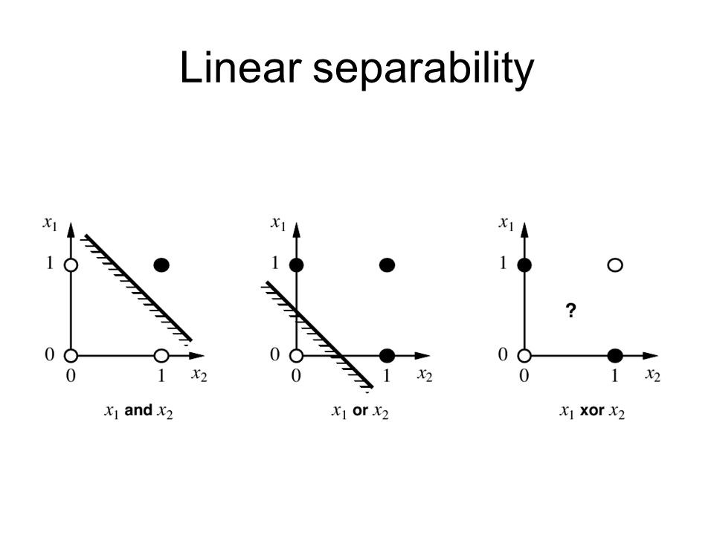
Complexity
Here the XOR needs two lines to be solved, which means at least two neurons in the network.
The number of neurons in the hidden layer could be specified by trial and error according to the complexity of the problem.

Slide 7
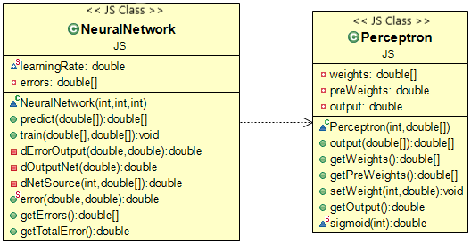
Multilayer NN UML

Slide 8
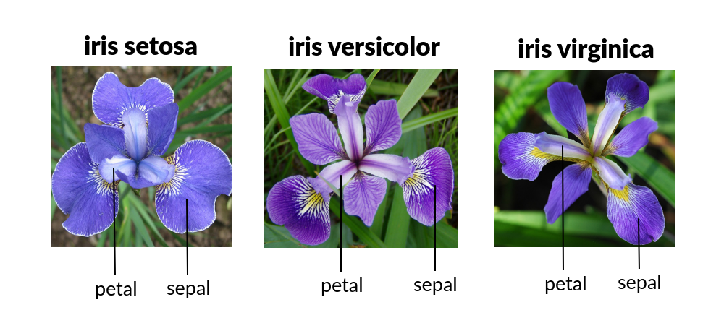
Iris Flower Type Prediction
We built the neural network and used a past data set that has information about the sepal and petal width and height of the iris flower. According to that, the type of iris flower will be Setosa, Virginica, or Versicolor.

Slide 9
The Neural Network Structure
Fully connects NN:
Input Layer of 4 inputs =>
Sepal length sepal width petal length petal width
Hidden Layer of 4 Perceptron based on trial and error
Output Layer of 3 Perceptron as we have three possible outputs => Setosa, Virginica, or Versicolor

Slide 10
The Neural Network Structure
Because the perceptron output is range from 0 to 1 (Sigmoid is used), so we did data preprocessing to change the types to numbers:
"Virginica": 0
"Versicolor": 1
"Setosa": 2
The output of the NN will be an array of 3 numbers, each is from 0 to 1. We round the numbers to have an array of zeros and one, then the index of that one the flower type predicted by the machine.
Ex: [0, 0, 1] => index of 1 is 2 and 2 is Setosa

Slide 11
Training the Neural Network
We separated the data randomly to training and testing sets. To get suitable results we train the neural network on that data set for 1000 epochs. Each epoch will train the NN of all rows in the training set (105 data).
After training the neural network on the data provided, the error reduced and we saved the weights in a model to be used later without training it again.

Slide 12
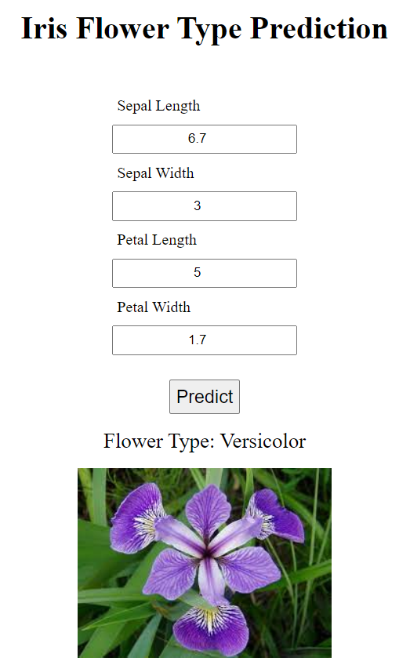
Results
So, the prediction is right for this test data that the machine did not trained on it before ([6.7, 3, 5, 1.7], [1]), 1 is Versicolor

